Slide 1
Section 10.2: Epidemic Modeling
Shanthni Ravindrababu

Slide 2
Guiding Hypotheses
Defined by 2 hypothesis: Compartmentalizations and Homogenous Mixing
Homogenous mixing assumes has the same chance of coming into contact with an infected person
Susceptible (S) | Healthy individuals who have not contracted the pathogen
Infectious (I) | Individuals who are actively contagious and can spread the pathogen
Recovered (R) | Individuals who have been infectious and recovered, and cannot spread the pathogen anymore

Slide 3
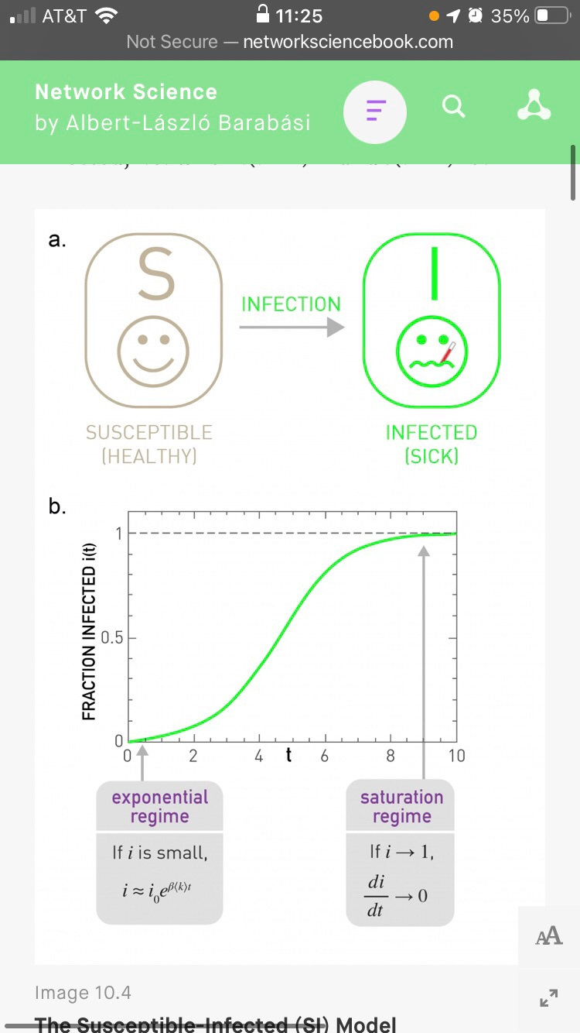
Susceptible-Infected model
Individual can be in one of two states: susceptible or infected
As time goes on, this model assumes everyone will become infected

Slide 4
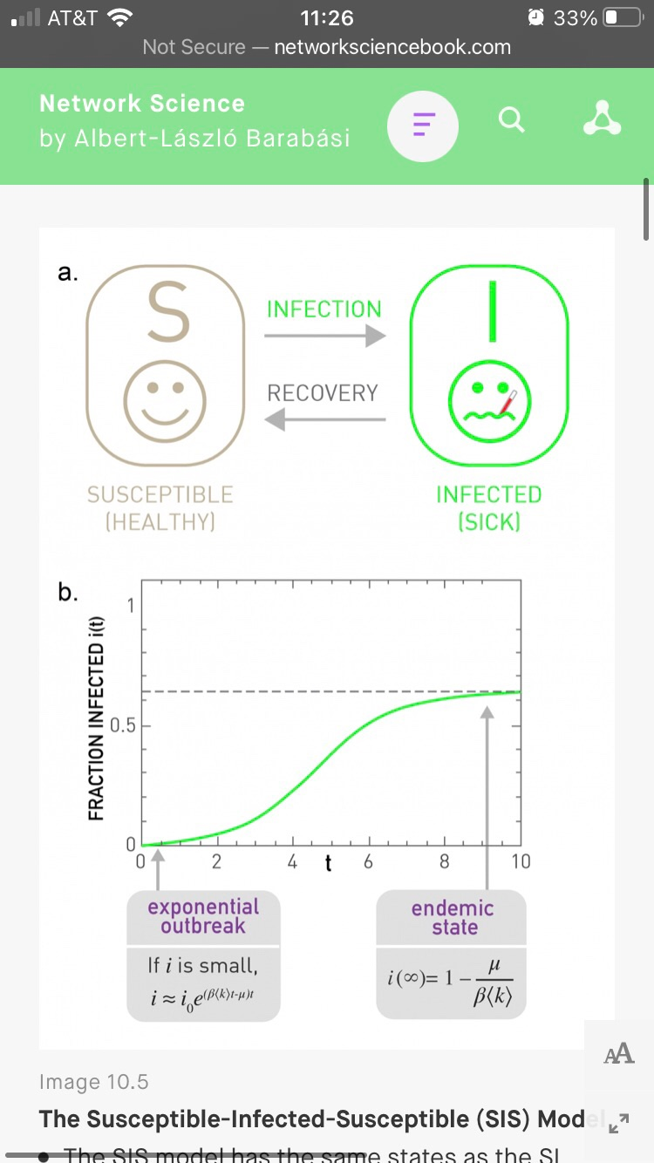
Susceptible-Infected Susceptible Model
Similar to the previous model, but accounts for the recovery of infected people
As time goes on, the model either reaches an endemic state or a disease free state

Slide 5
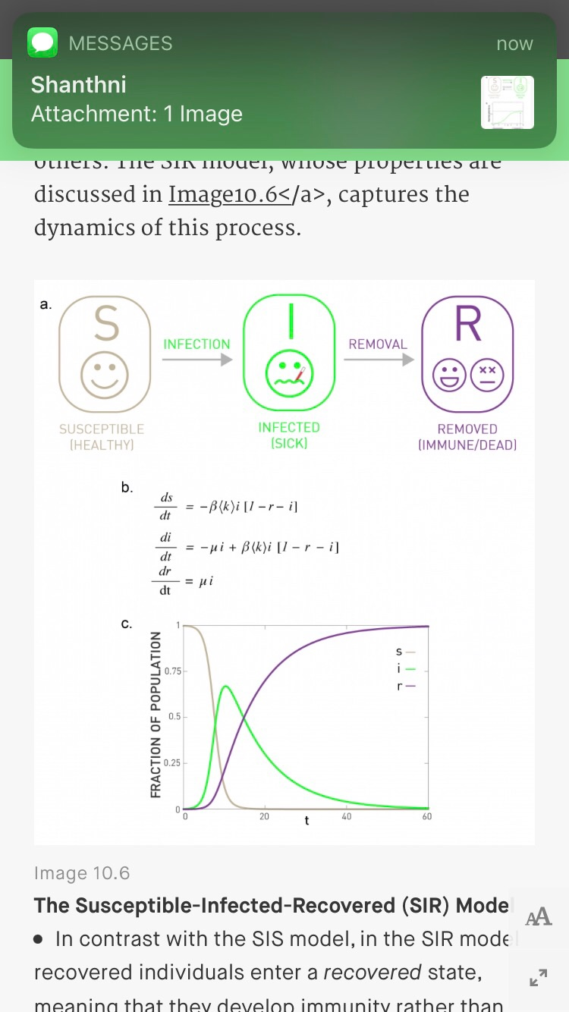
Susceptible-Infected-Recovered Model
Includes a recovered state to the previous models
This model accounts for individuals gaining immunity or dying from the pathogen after infection

